Slide 1

INTRODUCTION TO YOUR PROJECT
1. Project Overview
Develop a basic chatbot designed to assist individuals seeking mental health support.
The chatbot will provide resources, coping strategies, and a listening ear for users experiencing mental health challenges.
\2. Project Objectives
Offer immediate support to individuals in need.
Provide accessible mental health resources and information.
Reduce the stigma associated with seeking mental health help by offering a confidential and safe platform.
SUMMER HACK

Slide 2

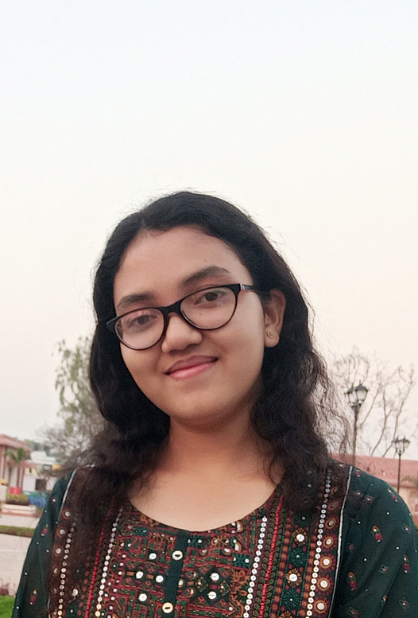
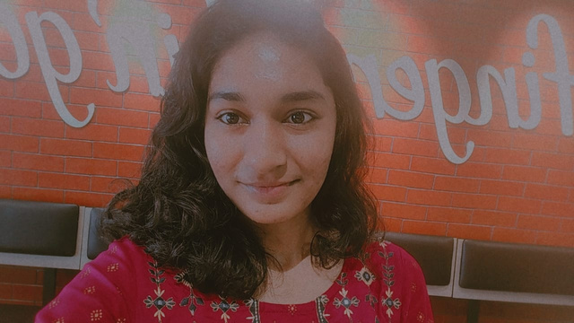
INTRODUCE YOUR TEAM
ARCHANA SWAIN
LIPIKA MUNDA
SRUTI SMARANIKA KAR
AI/ML & BACKEND DEVELOPER
UI DESIGNER & FRONTEND DEVELOPER
UI DESIGNER & FRONTEND DEVELOPER
SUMMER HACK

Slide 3
PROBLEM STATEMENT:
Challenges in Mental Health Support:
Many individuals are hesitant to seek professional help due to stigma or lack of access.
There is a growing need for immediate, accessible mental health resources.
Overwhelmed mental health services and long wait times for professional support.
Solution:
Implement a chatbot that provides initial mental health support and resources to users, acting as a first point of contact.
SUMMER HACK

Slide 4
STACK YOU ARE PLANNING TO USE:
Fontend - Html, CSS, Javascript, React
Backend - Django, database
AI/ML- Python, Generative AI, LLM, Langchain, NPL, APIs, Deep Learning
UI - Figma
SUMMER HACK

Slide 5
BLUEPRINT OF THE TOOL:
Set Up the Django Project
Create a Django App
Add the App to the Project
Add chatbot to the INSTALLED_APPS list in chatbot_project/settings.py
Define the URL Pattern In chatbot/urls.py
Create the View In chatbot/views.py
Configure Open AI API
Migrate and Run the Server
Test the Chatbot
Deploy Your Django Application
SUMMER HACK

